Slide 1
ASP.NET API

Slide 2
Evolution to Web API
During the late ’90s, web development started shifting from static content to active content and applications, using server-based technologies such as CGI, Active Server Pages (ASP), Java, and PHP.
This shift ignited a transformation that is ongoing today: moving applications from the desktop and into the browser.
A major accelerator of that shift was XMLHTTP, originally shipped with Internet Explorer 5, which when combined with JavaScript, allowed web developers to communicate back from their browser applications to the server.
Now the world is awash in browser-based applications.
Early versions of ASP.NET MVC included the ability to write controllers that behaved more like APIs than web pages, through the use of things such as the JsonResult class.
However, there was always a bit of a programming model mismatch, with API authors desiring to have complete control over HTTP, which ASP.NET’s abstractions made difficult, and ASP.NET MVC did not resolve.
ASP.NET Web API, first shipped in 2011, resolves this discontinuity with a first class, HTTP-centric programming model.

Slide 3
Why Web API?
When MVC developers ask the author to give the elevator pitch for Web API, he usually says:
ASP.NET MVC excels at accepting form data and generating HTML;
ASP.NET Web API excels at accepting and generating structured data like JSON and XML.”

Slide 4
MVC and API are very consistent
The Web API team went to great lengths to allow you to leverage your existing ASP.NET MVC experience with controllers, actions, filters, model binders, dependency injection, and the like.
Many of these same concepts appear in Web API in very similar forms, which makes applications that combine MVC and Web API seem well integrated.
Because ASP.NET Web API is an entirely separate framework, it probably warrants a book of its own.

Slide 5
The ASP.NET Project wizard
* Allows user to add Web API features to any project type, including Web Forms and MVC applications.
* The special project type “Web API” not only includes the Web API binaries, but also a sample API controller (called ValuesController) and some MVC code that can automatically generate help pages for your Web APIs.

Slide 6
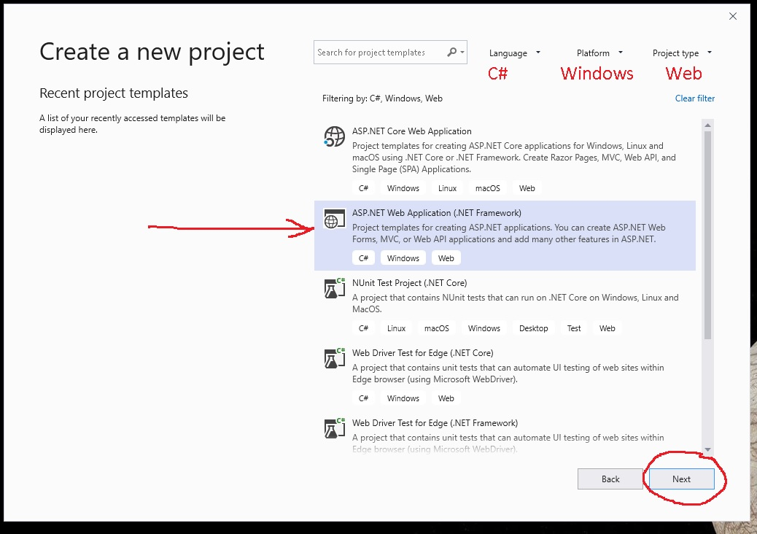

Slide 7
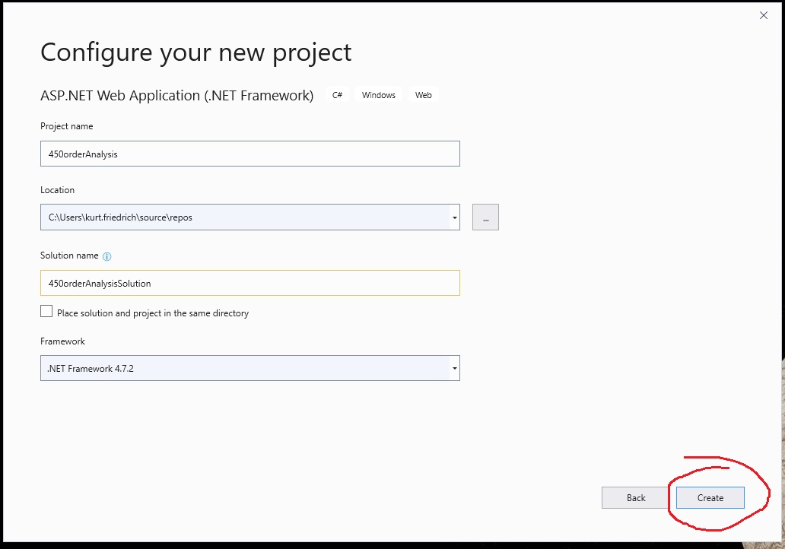

Slide 8
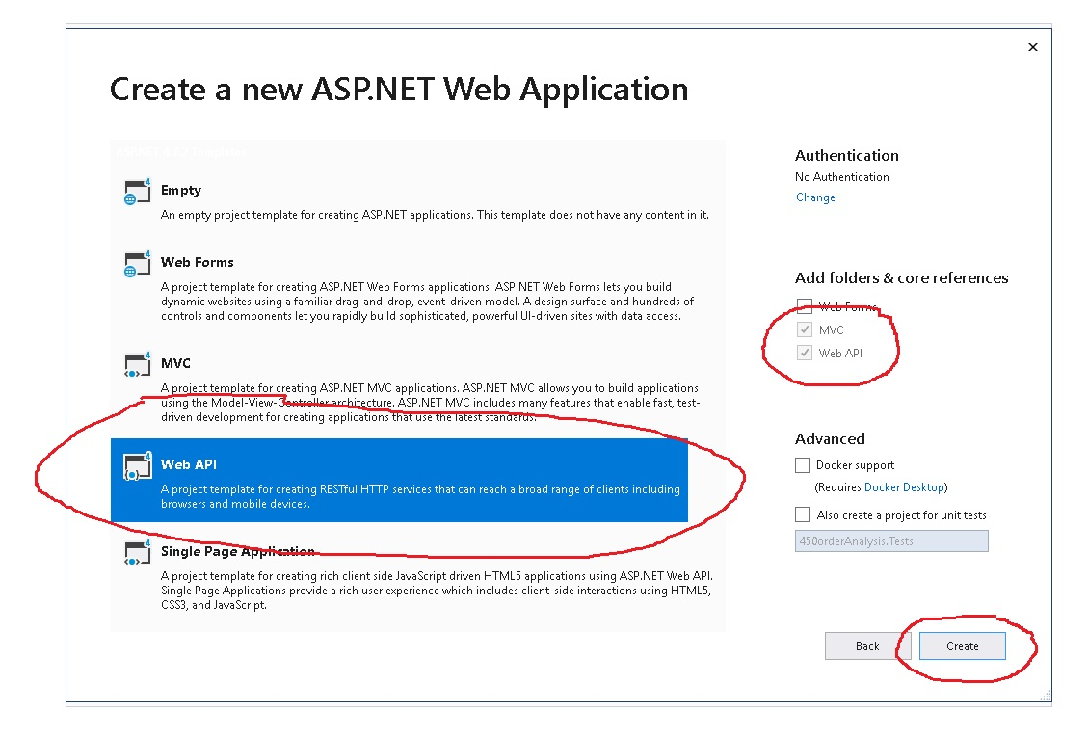

Slide 9
API not modeled on MVC pattern
Web API ships with MVC, and both utilize controllers.
However, Web API does not share the Model-View-Controller design of MVC.
They both share the notion of mapping HTTP requests to controller actions, but rather than MVC’s pattern of using an output template and view engine to render a result, Web API directly renders the resulting model object as the “response”.
Many of the design differences between Web API and MVC controllers come from this core difference between the two frameworks.

Slide 10
Examining the Sample ValuesController
Notice that the methods in the controller return raw objects rather than views (or other action results). Instead of returning views composed of HTML, the objects that API controllers return are transformed into the best matched format that the request asked for.
Also different is the dispatching differences between MVC and Web API. Whereas MVC controllers always dispatch to actions by name, Web API controllers by default dispatch to actions by HTTP verb.
Although you can use verb override attributes such as [HttpGet] or [HttpPost], most of your verb-based actions will probably follow the pattern of starting the action name with the verb name.
The action methods in the sample controller are named directly after the verb, but they could also have just started with the verb name (meaning Get and GetValues are both reachable with the GET verb).

Slide 11
Getting to a Get
public IHttpActionResult GetProduct(int id) // works
{
public IHttpActionResult Product(int id) // does not work
{
[HttpGet]
public IHttpActionResult Product(int id) // works
{

Slide 12
Examining the Sample ValuesController
It’s also worth noting that ApiController is defined in the namespace System.Web.Http and not in System.Web.Mvc where Controller is defined.
When we discuss self-hosting later, the reason for this will be clearer, but basically, you can host a Web API controller in several different types of hosts.

Slide 13
Web API controllers are asynchronous by design
The HttpRequestMessage and HttpResponseMessage classes form the basis of the HTTP support in System.Net.Http.
The design of these classes have handlers in this stack are given a request message and expected to return a response message.
This also means that rather than writing directly to a response stream, the developer instead returns an object that describes the response (and can later render it when needed).

Slide 14
Incoming Action Parameters
To accept incoming values from the request, you can put parameters on your action and the Web API framework will automatically provide values for those action parameters.
There is a strong line drawn between values from the HTTP body and values taken from the URI.
By default, Web API will assume that
parameters that are simple types (that is, the intrinsic types, strings, dates, times, and anything with a type converter from strings) are taken from URI values, and are handled by a model binding system.
and complex types (everything else) are taken from the body, and, only a single value can come from the body, and that value must represent the entirety of the body. Incoming (and outgoing bodies), are handled by a concept called formatters.

Slide 15
Action Return Values, Errors, and Asynchrony
Web API controllers send values back to the client by way of the return value of the action.
Actions in Web API can return an object of type HttpResponseMessage to represent the response to send back to the client.
Returning a response object is a fairly low-level operation, so Web API controllers almost always return a raw object value or an action result (a class that implements IHttpActionResult) instead.
When an action returns a raw object, Web API will automatically convert it into a structured response in the desired format (such as JSON or XML) using a feature of Web API called Content Negotiation.

Slide 16
What if things don’t go well?
When the signature of your action is strongly tied to the type of the return value that you want to use for success, how can you easily support returning some different representation for errors?
If you change the signature of the action to HttpResponseMessage, it complicates the controller action (and unit testing).
To solve this dilemma, Web API allows developers to throw HttpResponseException from their actions to indicate that they are returning an HttpResponseMessage rather than successful object data. In this way, actions that have errors can formulate a new response and throw the response exception, and the Web API framework will treat the response as though the action directly returned that response message.
Successful responses, then, can continue to return their raw object data and gain the benefits of simpler unit testing.
Web API 2 introduced a better solution to this problem: the new action result classes. To return action results, Web API controller actions use a return value type of IHttpActionResult.
The ApiController class includes many sets of methods that directly return action results; see next slide for their behavior

Slide 17
BadRequest: Returns an HTTP 400 (“Bad Request”). Optionally includes either a message or an automatically formatted error class based on validation errors in a ModelStateDictionary.
Conflict: Returns an HTTP 409 (“Conflict”).
Content: Returns content (similar to the behavior of an action method that returns a raw object). Content format is automatically negotiated, or optionally the developer can specify the media type formatter and/or the content type of the response. The developer chooses which HTTP status code the response uses.
Created: Returns an HTTP 201 (“Created”). The Location header is set to the provided URL location.
CreatedAtRoute: Returns an HTTP 201 (“Created”). The Location header is set to the URL that is constructed based on the provided route name and route values.
InternalServerError: Returns an HTTP 500 (“Internal Server Error”). Optionally includes content derived from the provided exception.
Json: Returns an HTTP 200 (“OK”), with the provided content formatted as JSON. Optionally formats the content with the provided serializer settings and/or character encoding.
NotFound: Returns an HTTP 404 (“Not Found”).
Ok: Returns an HTTP 200 (“OK”). Optionally includes content whose format is automatically negotiated (to specify the exact format, use the Content method instead).
Redirect: Returns an HTTP 302 (“Found”). The Location header is set to the provided URL location.
RedirectToRoute: Returns an HTTP 302 (“Found”). The Location header is set to the URL that is constructed based on the provided route name and route values.
ResponseMessage: Returns the provided HttpResponseMessage.
StatusCode: Returns a response with the provided HTTP status code (and an empty response body).
Unauthorized: Returns an HTTP 401 (“Unauthorized”). The authentication header is set to the provided authentication header values.

Slide 18
Configuration in Web-Hosted Web API
The default MVC project templates are all web-hosted projects because MVC only supports webhosting.
Inside the App_Startup folder are the startup configuration files for your MVC application.
The Web API configuration code is in WebApiConfig.cs , and looks something like this:
public static class WebApiConfig {
public static void Register(HttpConfiguration config) {
// Web API configuration and services
// Web API routes
config.Routes.MapHttpAttributeRoutes();
config.Routes.MapHttpRoute(
name: "DefaultApi",
routeTemplate: "api/{controller}/{id}",
defaults: new { id = RouteParameter.Optional }
);
}
}
Developers will make modifications to this file to reflect any configuration changes they want to make for their application.
The default contains a single route as an example to get you started.

Slide 19
Binding Parameters
The earlier mention about “body values” and “non-body values” says we need to discuss Formatters and Model Binders because those two classes are responsible for handling bodies and non-body values, respectively.
When you write an action method signature and include parameters,
complex types come from “the body,” which really means that formatters are responsible for generating them;
simple types come from “not the body,” which means that model binders are responsible for generating them.
For body content being sent, you use formatters to decode the data.
To tell the whole story, you need to rise up a level into a concept that is new to Web API: Parameter Binding.
Web API uses parameter binders to determine how to provide values for individual parameters.
You can use attributes to influence that decision (such as [ModelBinder]), but the default logic uses the simple type versus complex type logic when there are no overrides applied to influence the binding decision.

Slide 20
The Parameter Binding system looks to the action’s parameters to find any attributes that derive from ParameterBindingAttribute.
The following list shows a few such attributes that are built into Web API.

Slide 21
ModelBinderAttribute: This tells the parameter binding system to use model binding (meaning, create the value through the use of any registered model binders and value providers).
This is what is implied by the default binding logic for any parameter of a simple type.
FromUriAttribute: This is a specialization of ModelBindingAttribute that tells the system only to use value providers from factories, which implement IUriValueProviderFactory to limit the values bound to ensure that they come only from URI.
Out of the box, the route data and query string value providers in Web API implement this interface.
FromBodyAttribute: This tells the parameter binding system to use formatters (meaning, create the value by finding an implementation of MediaTypeFormatter, which can decode the body and create the given type from the decoded body data).
This is what is implied by the default binding logic for any complex type.

Slide 22
The parameter binding system
Is quite different from the way MVC works.
In MVC, all parameters are created through model binding.
Model binding in Web API works mostly the same way as MVC (model binders and providers, and value providers and factories), although it’s been re-factored quite a bit, based on the alternate model binding system from MVC Futures.
You will find built-in model binders for arrays, collections, dictionaries, simple types, and yes, even complex types (though you would need to use [ModelBinder] to get them to run).

Slide 23
Formatters
Are a new concept for Web API. Formatters are responsible for both consuming and producing body content.
You can think of them in much the same way you might think of serializers in .NET: classes that are responsible for encoding and decoding custom complex types into and out of the stream of bytes, which is the body content.
You can encode exactly one object into the body, and decode exactly one object back out of the body (although that object can contain nested objects, as you would expect of any complex type in .NET).
Built into Web API you will find three formatters, one which:
Encodes and decodes JSON (using Json.NET)
Encodes and decodes XML (using either DataContractSerializer or XmlSerializer)
Decodes form URL encoded from data in the body from a browser form post.
Each of these formatters is quite powerful, and will make its best effort to transcode its supported format into the class of your choosing.

Slide 24
Filtering Requests
You can apply filters
at the action level (for a single action),
at the controller level (for all actions in the controller),
and at the configuration level (for all actions on all controllers in the configuration).
Web API includes one filter in the box for developers to use, AuthorizeAttribute.
Much like its MVC counterpart, this attribute is used to decorate actions that require authorization, and includes the AllowAnonymousAttribute, which can selectively “undo” the AuthorizeAttribute.

Slide 25
WEB API EXAMPLE:
ProductsApp
Then ProductsAppEF
This Web config worked?
<connectionStrings>
<add name="ProductsDBContext" connectionString="Data Source=(localdb)\MSSQLLocalDB;
Initial Catalog=ProductsDBContext-20151106211526;
Integrated Security=True; MultipleActiveResultSets=True;
AttachDbFilename=|DataDirectory|ProductsDBContext-20151106211526.mdf"
providerName="System.Data.SqlClient" />
</connectionStrings>
<entityFramework>
<defaultConnectionFactory type="System.Data.Entity.Infrastructure.LocalDbConnectionFactory, EntityFramework">
<parameters>
<parameter value="mssqllocaldb" />
</parameters>
</defaultConnectionFactory>
<providers>
<provider invariantName="System.Data.SqlClient" type="System.Data.Entity.SqlServer.SqlProviderServices, EntityFramework.SqlServer" />
</providers>
</entityFramework>

